Slide 1

Handwritten Digit Classification
Brandon Park, Jungjae Park, Kyunghwan Min, Minjae Lee, Minseo Jang

Slide 2
Tools
Language
Data
Objective
Python
Multilayer Neural Network
MINIST Data set
Compare the Efficiency
Time Cost
Accuracy
Random Forest
Tree Boosting
Single Layer Neural Network

Slide 3
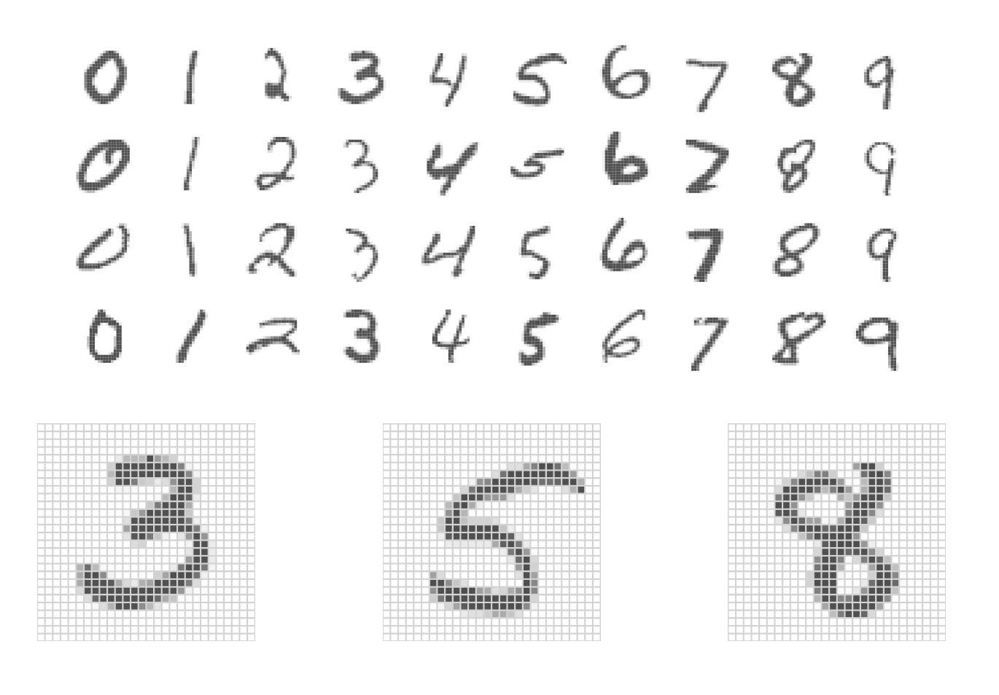
MNIST Data Set
Training set: 60000 Images
Test set: 10000 Images
Each images with 28 x 28 = 764 pixels
Each pixels have value of 0 – 255

Slide 4
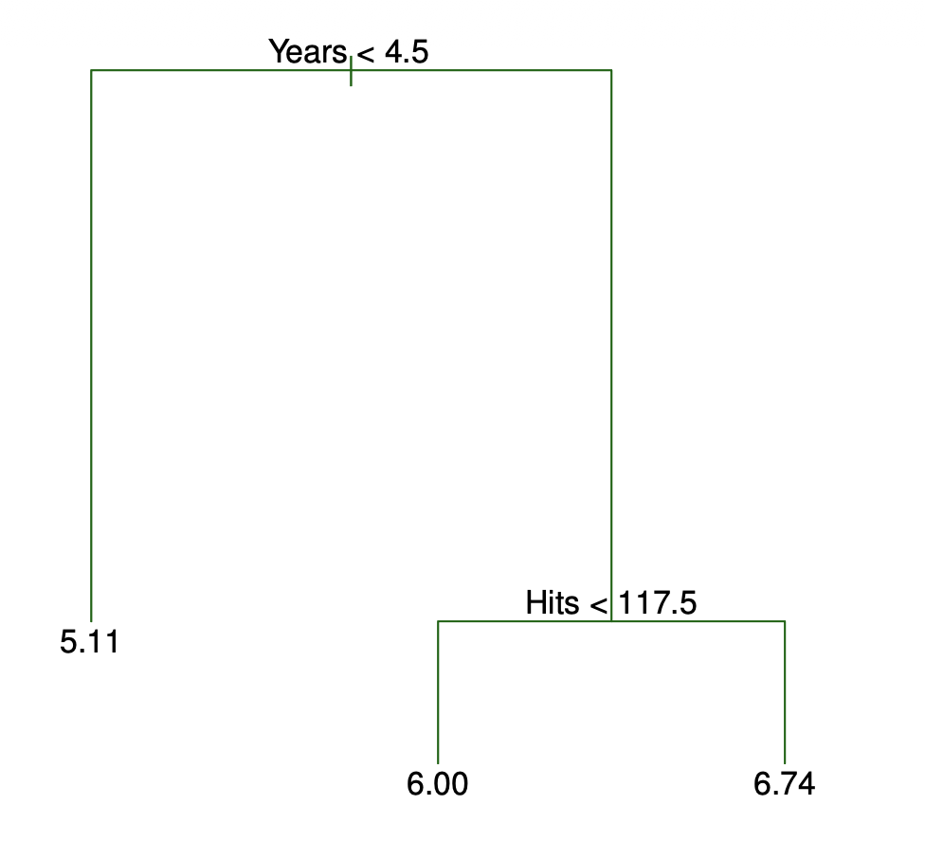
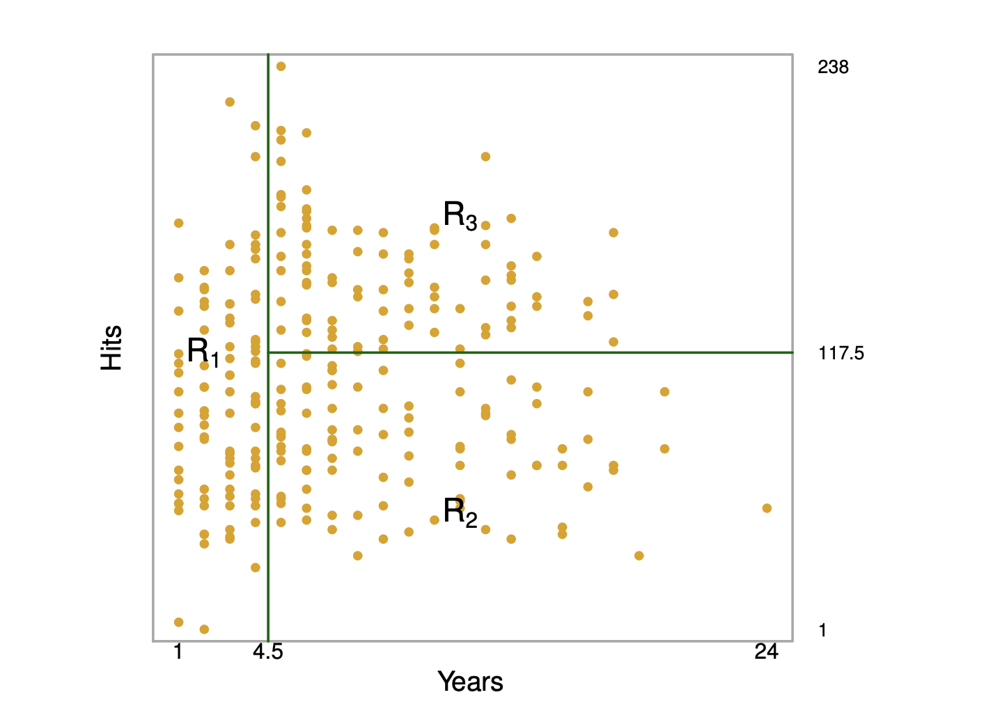
Trees

Slide 5
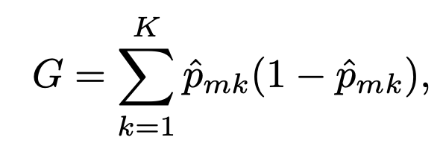
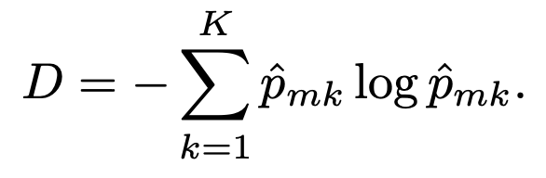
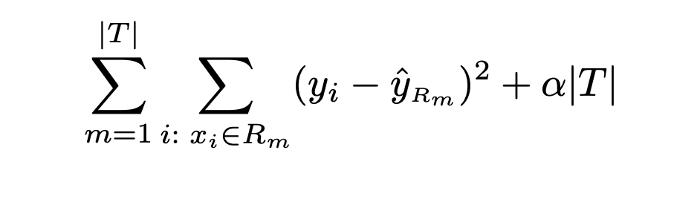
Building a Tree
Splitting a Tree
Find boxes that minimize classification error rate
Recursive binary splitting
  Greedy, top-down approach
Pruning a Tree
- Overfitting -> poor test set performance
Option 1 : threshold
Option 2 : pruning – cost complexity pruning

Slide 6
Random Forest
Problem 1 : high variance
- Bootstrap : lowering variance by averaging a set of observations
Problem 2 : correlation
- Same as bagging, at each split, a random sample of m predictors are only considered

Slide 7
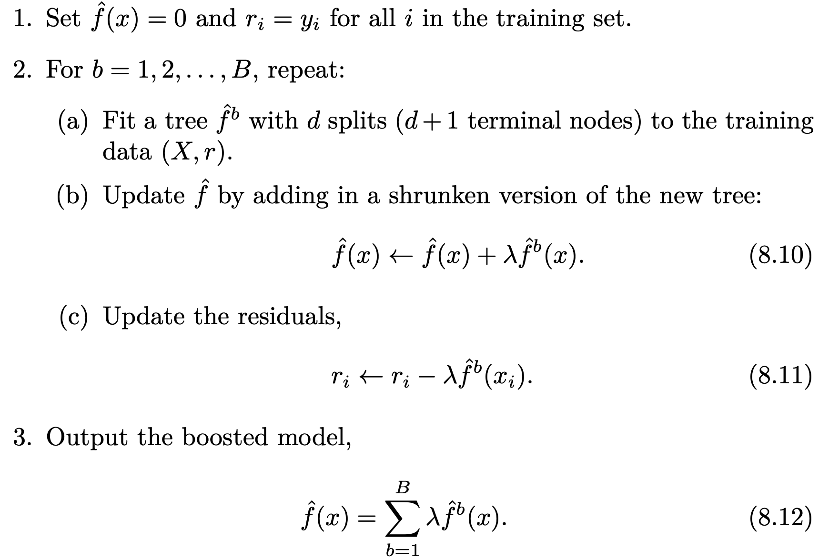

Boosting
Does not use bootstrapping
Grows sequentially
Three parameters
B : Number of Trees
λ : Shrinkage parameter
d : Number of Splits

Slide 8
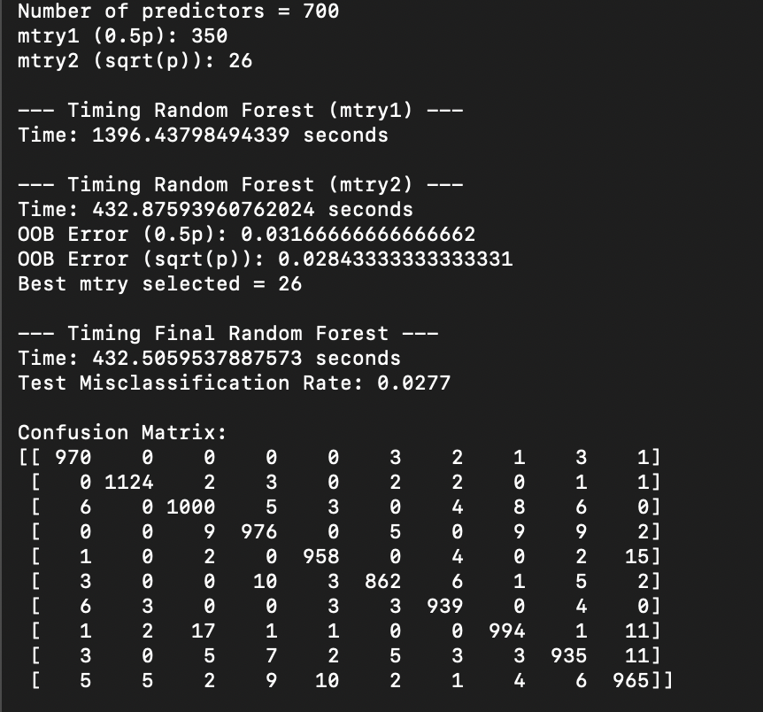
Result : Random Forest
Compared m values :
350 (p/2) vs 26 (√p)
26 was better : less correlation
Confusion matrix : strong diagonal

Slide 9
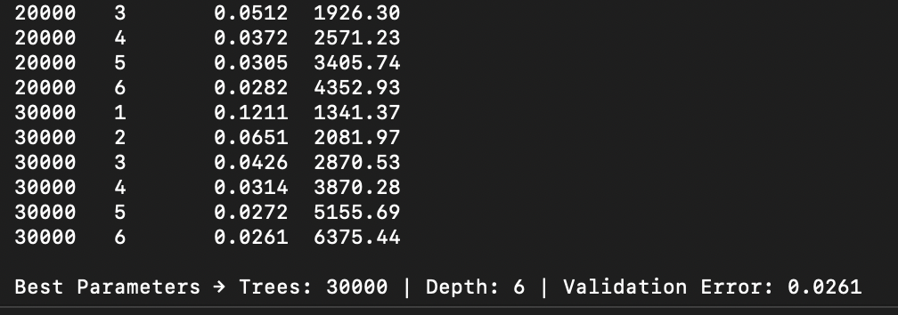
Result : Tree Boosting
Increasing depth led to lower error
Increasing number of trees led to lower error
Cannot see the effect of overfitting

Slide 10
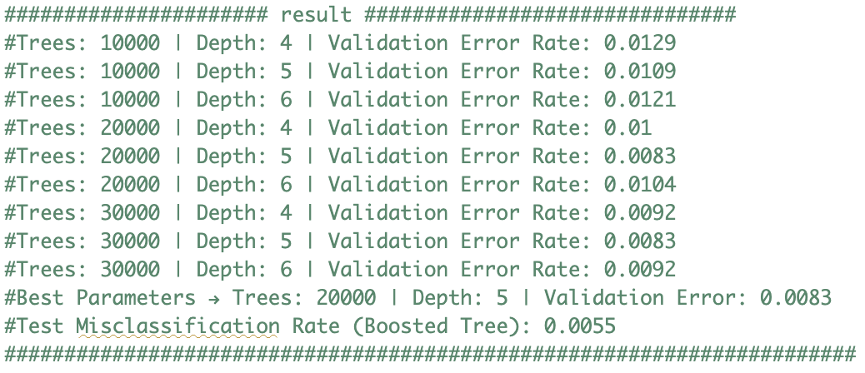
Overfitting
Original task: 10-class digit classification (0–9)
Modified task: Binary classification (digit 3 vs digit 8)
Reduces problem complexity and allows the model to reach high capacity more quickly

Slide 11
Single Layer Neural Network
Hidden layer function : RELU
Regularization : Dropout
Searched over :
Neutrons : 50, 100, 150, 200
Dropout : 0.2, 0.3, 0.4, 0.5
Batch size : 100, 200, 300
Learning rate : 0.01 (Adam)
Epoch : 5000
Best Parameters :
Neurons: 150 | Dropout: 0.2 | Batch Size: 300
Validation Error: 3.19%
Test Error : 3.85%

Slide 12
Result : Single NN
Increasing neurons generally improved validation error up to a point (capacity helps).
Too much dropout (0.5) often worsened performance (too much regularization).
Best NN achieved 3.85% test error, but required ~31 minutes of grid search, so tuning cost is significant.
Compared to your best tree ensembles, this simple 1-hidden-layer network is competitive but not the top performer.

Slide 13
Multilayer Neural Network
Learning rate: 0.001 (Adam)
Epoch: 5000
Searched for :
- L1 (1st layer): 50, 100, 150, 200
- L2 (2nd layer): 50, 100, 150, 200
- Drop1: 0.2, 0.3, 0.4, 0.5
- Drop2: 0.2, 0.3, 0.4, 0.5
- Batch size: 100, 200, 300
Best Parameters:
L1: 150 | L2: 50 | Drop1: 0.2 | Drop2: 0.2 | Batch Size: 300
Validation Error: 2.44%
Test Error: 3.39%

Slide 14
Multilayer Neural Network
- The second hidden layer mainly refines these features, so fewer units are sufficient.
- Low dropout provides mild regularization without removing too much information.
- Higher dropout values led to underfitting and worse validation performance.
- Larger batches produce more stable gradient updates when using Adam with a small learning rate.

Slide 15
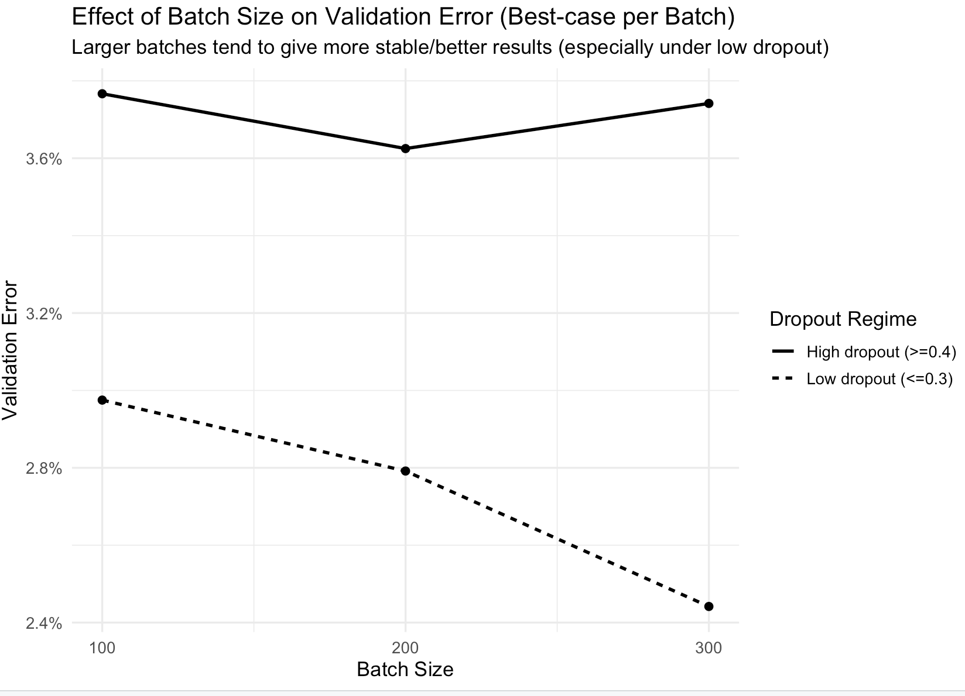
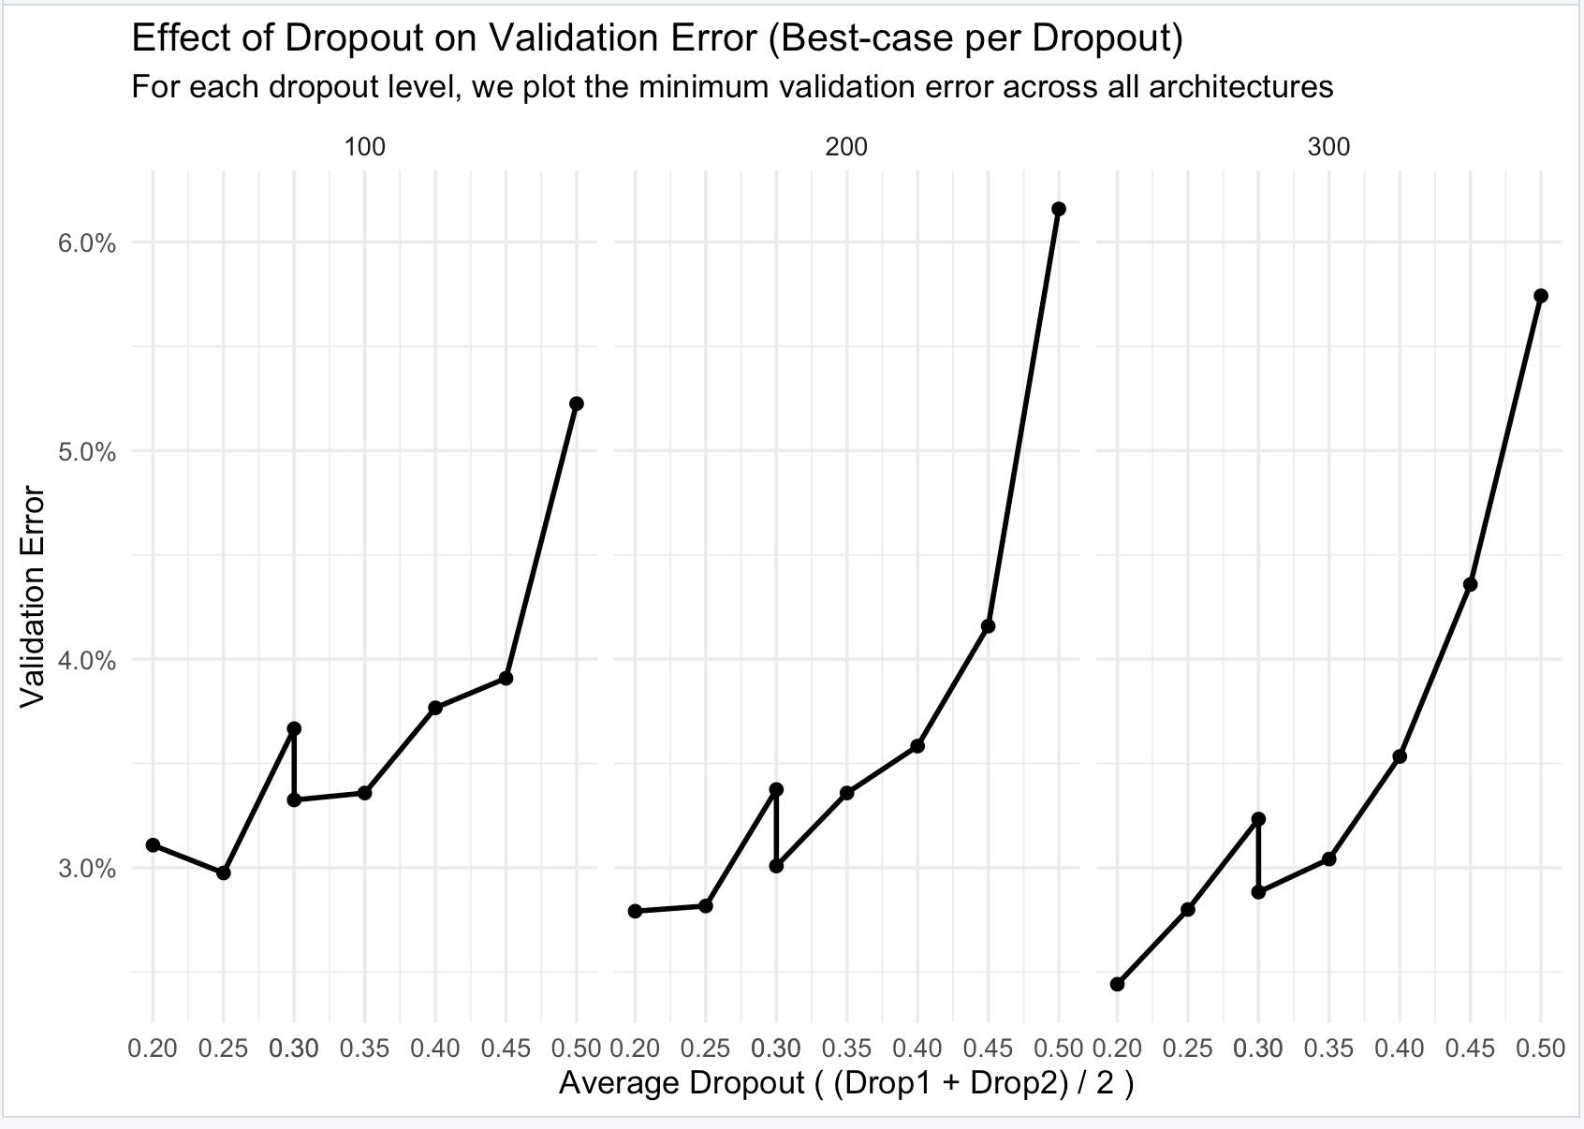

Slide 16
Comparison with Single NN
Hidden unit allocation differs
Single-layer NN requires many units (150) in one layer because it performs feature extraction and classification together.
Multi-layer NN distributes capacity across layers, reducing bias more efficiently.
Regularization strength is unchanged
Both models selected dropout = 0.2, showing that stronger regularization is unnecessary for MNIST.
Over-regularization leads to underfitting in both cases.
Batch size remains the same
Batch size = 300 is optimal for training stability in both architectures.
Optimization behavior does not change with depth.
Performance improvement source
The multi-layer NN improves accuracy by learning hierarchical representations.
Gains are moderate, reflecting diminishing returns on this well-structured dataset.

Slide 17
References
James, G., Witten, D., Hastie, T., & Tibshirani, R. (2021). An introduction to statistical learning: With applications in R (2nd ed.). Springer.
LeCun, Y., Cortes, C., & Burges, C. J. C. (1998). The MNIST database of handwritten digits. http://yann.lecun.com/exdb/mnist/
Pedregosa, F., Varoquaux, G., Gramfort, A., Michel, V., Thirion, B., Grisel, O., … Duchesnay, É. (2011). Scikit-learn: Machine learning in Python. Journal of Machine Learning Research, 12, 2825–2830.
Chen, T., & Guestrin, C. (2016). XGBoost: A scalable tree boosting system. In Proceedings of the 22nd ACM SIGKDD International Conference on Knowledge Discovery and Data Mining (pp. 785–794). ACM.
Abadi, M., Agarwal, A., Barham, P., Brevdo, E., Chen, Z., Citro, C., … Zheng, X. (2016). TensorFlow: Large-scale machine learning on heterogeneous systems. https://www.tensorflow.org/
Chollet, F., et al. (2015). Keras. https://keras.io

